Slide 1
American History
1
Talk 15: California and Gold Rush

Slide 2
Talk | Title | Time Period | Date of Talk
8 | The early Republic | 1792-1800 | October 30th
9 | Jefferson’s America | 1800-1808 | November 6th
10 | War of 1812 and its impact | 1808-1815 | November 20th
11 | The Era of Good Feelings | 1816-1828 | December 4th
12 | Jacksonian ‘democracy’ | 1828-1840 | January 15th
13 | New Spain, Mexico and the Texas Republic | 1820-1836 | January 29th
14 | Manifest Destiny and the Mexican War | 1840 -1850 | February 5th
15 | California and the Gold Rush | 1700-1850 | February 19th

Slide 3
Overview
A quick tour
Pre Gold Rush California
Gold!
1849
The Golden State
Women during the Gold Rush
Legacy and Impact on culture

Slide 4
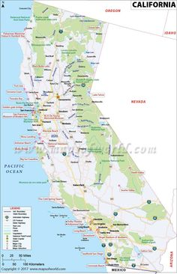
California
Forested
Warm
wet
Multiple climates
Water in the north
& mountains
Delta
Rivers
mountainous
South &Central
Dry, hot, flat
Inland
Hot Dry
flat
High
Desert
Mediterranean
Mediterranean
Climate coast to
10 miles inland
Low
Desert

Slide 5
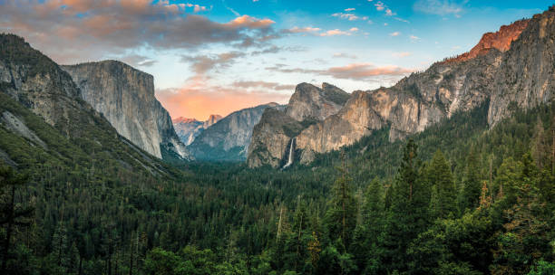
Sierra Nevada Mountains

Slide 6
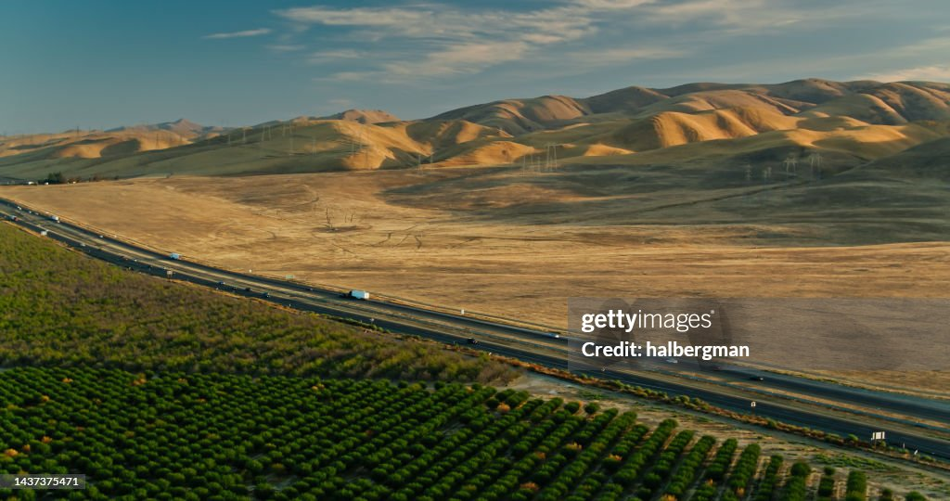
San Joaquin Valley, Central California

Slide 7
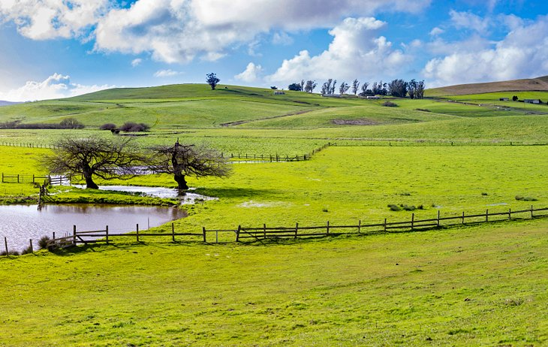
Napa Valley, Central California

Slide 8
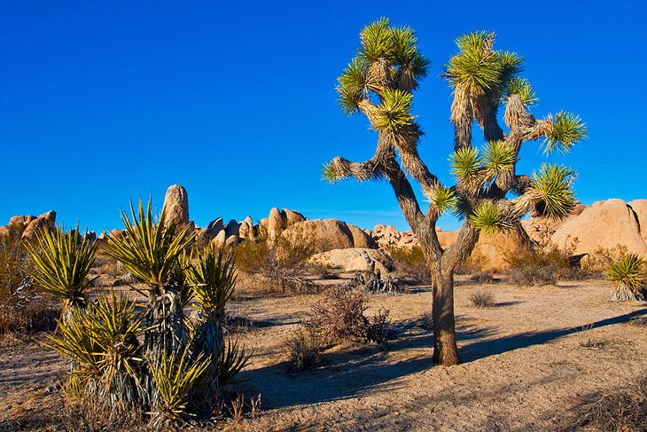
High Desert Joshua Tree National Park

Slide 9
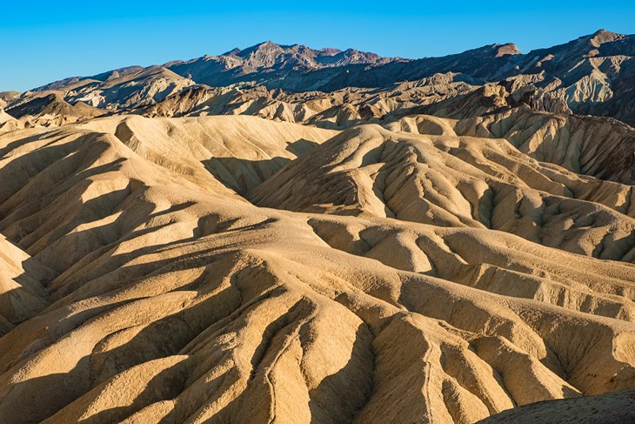
Zabriskie Point Death Valley

Slide 10
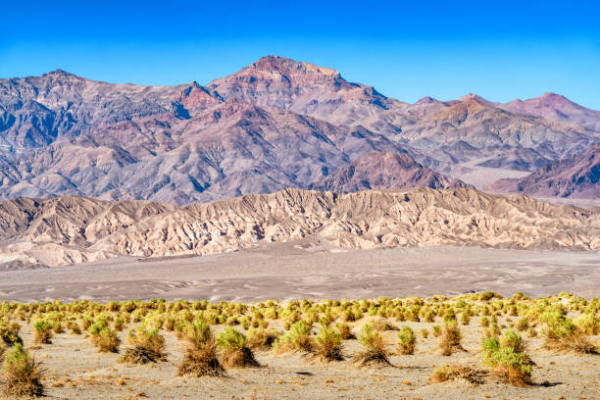
Mojave Desert: low desert

Slide 11
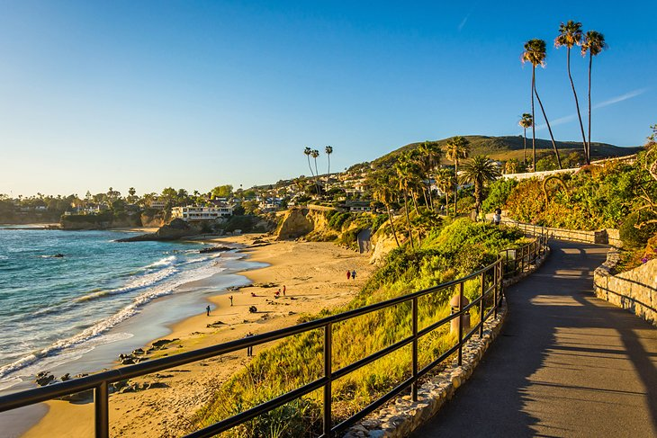
Laguna Beach Southern California

Slide 12
California before the gold

Slide 13
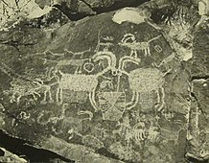
California Indigenous peoples
Inhabited for 19,000 years +
Most densely populated area of
Pre European America
350,000 inhabitant, 500 tribes
Bands ranging from 50-500
A managed landscape: Forest gardening via controlled burning &diet of processed acorns and fish
Settled communities with agreed boundaries and substantial trade, no evidence of warfare….abundance of land & wildlife

Slide 14
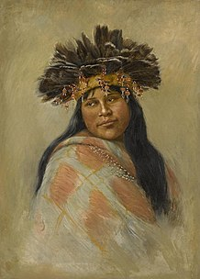
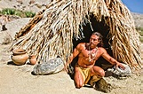
Many cultures, mountain, forest, temporary thatched housing

Slide 15
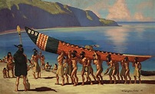
Ocean going plank canoes….densely populated islands….Polynesian influence?

Slide 16
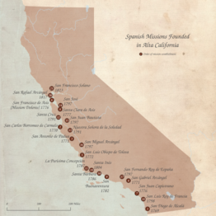
Spanish California (1769-1820)
Discovered and claimed by Spain1540’s…’Alta California’ too remote to colonise
No return till 1769…Spanish learn of
Russian presence in Alaska
Viceroy orders expedition of
Franciscans/ Spanish soldiers/Baha
California Indians
Objective ‘make Indians ‘Spanish’
Working class of settlers for ‘Dons’….ruling class .. land grants
Build 23 Missions/ Praesidios/ Pueblos
1769-1833 where most Indians live
Interior left unexplored

Slide 17
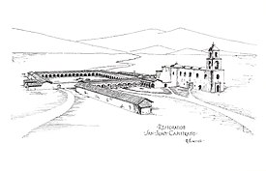
Mission, Pueblo, Presidio Complex @ 1830
Praesidios: garrison (no
More than 10 Spanish soldiers plus Indian converts)
Pueblos: Indian housing…
Unmarried women separated
From husbands,
Mission: worship,
Administration and
place of work

Slide 18
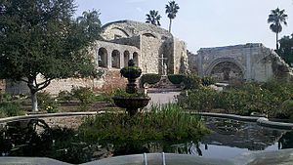
Mission San Juan Capistrano

Slide 19
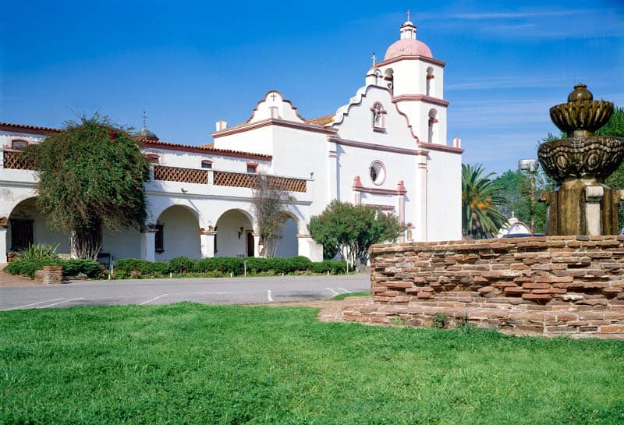
Mission San Juan Luis Rey (rec
Mission abandoned 1830’s
And turned to ruin
Restored in 1930’s during
Depression as tourist
attractions
Ongoing restoration to
Recreate 1800 look

Slide 20
Key facts about Missions & Indians
Indians persuaded not forced to enter Mission and live in Pueblos
Entering the mission an irrevocable decision
Indian required to abandon lifestyle, diet, language, religion
No one allowed to leave. Escapees chased and recaptured ..rejected by non Mission Indians….fear of disease
Discipline harsh and enforced by Indians themselves
Missions places of work: farming, Construction, Vineyards, ..cattle ranching early 1800
Indian population collapsed due to lack of immunity to disease, living closely together, change in diet, and culture shock….not intentional

Slide 21
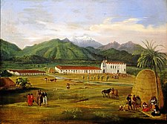
Mission life 1770-1830
A network of
Communities that
lasts only 60 years
Interior unoccupied..
And 80% colony
not explored
Cattle introduced
1790’s as Spanish
seek to make colony
Profitable. Ranchos
Set up across colony

Slide 22
Mexican California (1820-1846)
Mexican revolution ‘mostly anti clerical’….close Missions 1830
450 land grants issued to 40-40 Mexican wealthy ‘creoles’
Mission Indians become vaqueros to support cattle and farm workers
Population in 1846 less than 10,000, centred on 40-50 key families

Slide 23
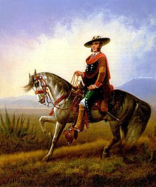
Lords of the Rancho Culture

Slide 24
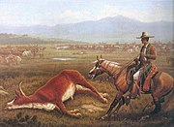
Vaqueros
Vast estates, elite
Land owners
Across South &
Central California
Casual lifestyle
Centred around
ranchos
Famous of horses
& horsemanship

Slide 25
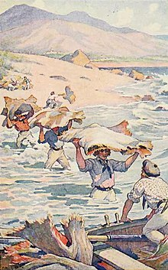
Hides hauled to off-shore traders
Meat left to rot…no consumers
Or transport
Cattle reared for Hides and tallow…Hauled to coast
and stacked
Ships patrol coast looking
For hide stacks..approach
And collect…and pay
Shipped to China, Hawaii
East Coast of USA

Slide 26
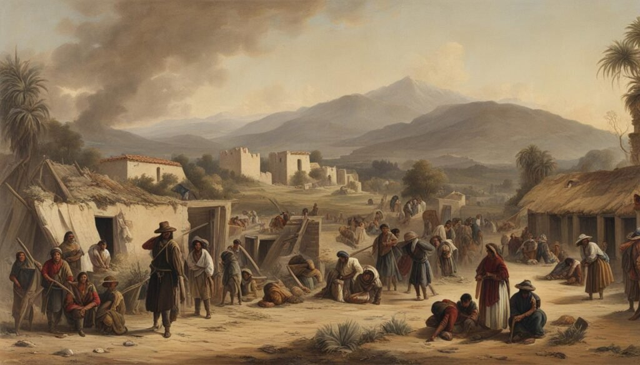
Los Angeles 1830
Los Angeles
Largest ‘town’...
…300 inhabitants

Slide 27
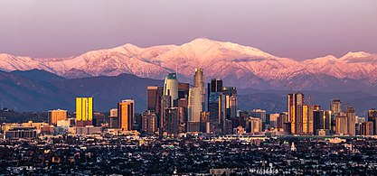
It’s changed…………..

Slide 28
Arrival of the ‘Anglos’
Settlers from United Starts begin arriving 1830’s…settle in North to farm…Russians building forts along coast…
The problem for Mexico: how to develop & keep remote place
Mexican governor needs contractor to develop area and keep it
loyal……need Contractor (like Steve Austin in Texas)

Slide 29
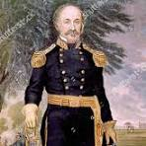
Johann Augustus Sutter ( 1803-1880)
Swiss born son of foreman, store clerk, marries rich widow…takes money, abandons wife & children, emigrates to US…with her money
Joins missionaries to California, to Hawaii, trades with Russians …back to California…
Has a dream to create “Agricultural Empire”
Rebrands as “Captain Sutter” Swiss Guard
To Mexico, meets Viceroy with plan of Agricultural Empire….secures 48,000 acre Land grant ‘Inland’ to develop area and act as “buffer” to block American settlers moving from East and North

Slide 30
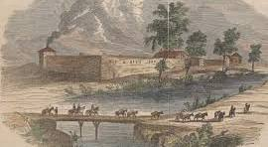
New Helvetia 1848
New Helvetia….employing 600
Indians…slave labour…
Creates “army” 150 strong
Indians in Swiss uniforms…
Organises massacre of Indians
Stealing cattle. Relies on
execution & starvation to control
Ignores contract, encourages
Anglo settlers. Mexican suspect
Slavery…child molestation
Supports ‘Bear Flag’ Republic &
Celebrates US victory vs Mexico
Decides to expand works
Feb 1848 sends employee
Mormon John Marshall to build
saw mill 40 miles from New Helvetia

Slide 31
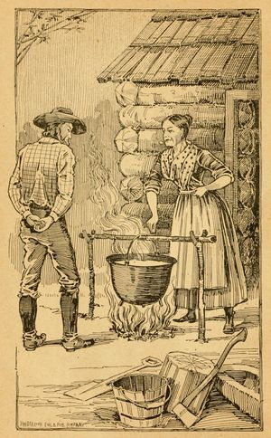
Gold confirmed
Marshal finds gold nugget, allows men
to find more during non working time
Marshall to New Helvetia…leaves men
to continue building saw mill
Test gold with Sutter, consult Encyclopaedia & woman to test by heat….confirmed
Sutter swears Marshall and employees
to secrecy…Sutter wants to secure lease
of Land to protect from miners ..sends
Marshal to San Francisco to secure land
Too late..

Slide 32
Samuel Brannon
Mormon newspaper man hardware store owner and church member…
Marshall employees pay for Goods
with gold dust
Brannon rushes to San Francisco
Buys all shovel and pans for cents
Runs through town shouting
“Gold” “Gold” sells pans for $15
Shovels $20..makes $36,000 ($1.4m in 2 weeks. California's
First millionaire
News spread by steamship

Slide 33
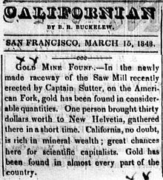
Spreading the news
New York June 1848
San Francisco March 1848
And by October news is spread across the world.

Slide 34
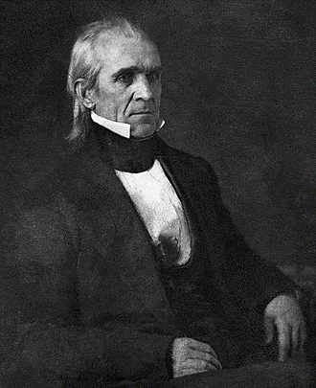
Official Confirmation Required
President Polk
The key trigger in “age of deference”
…voice of authority
“The accounts of the abundance of gold in that territory are of such an extraordinary character as would scarcely command belief were they not corroborated by the authentic reports of officers in the public service who have visited the mineral district and derived the facts which they detail from personal observation. ”
President Polk, State of Union Jan 1849
The race to California was on……

Slide 35
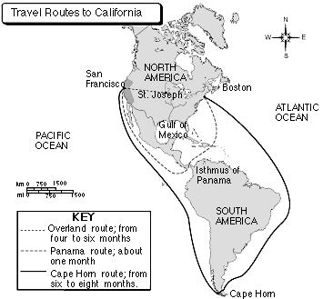
The Great Ocean & Land Migration
….6,000 most by sea 200 Chinese & Hawaiians
5 Months
1849…90,000 gold seekers
Arrive …60,000 Americans
…..rest European. Chileans, & Mexican ….50% by land/ 50% sea
1 month
7 Months
300,000 arrive by 1852 including 20,000 Chinese & Hawaiian islanders

Slide 36
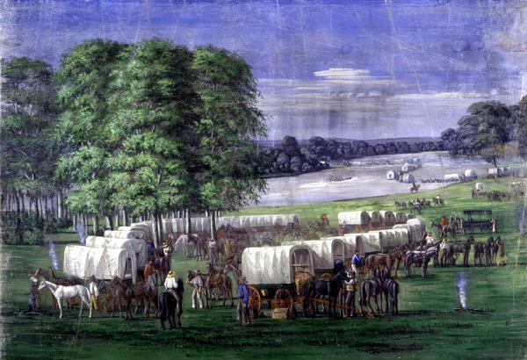
Overland Route
Travelled by steam boat
to assemble on Mississippi
Scores, if not 100’s of
wagons
Organized into “Companies”
…dissolve on arrival
Journey of 1,500 miles
Moving 10-15 miles per day
…race to beat snowfall
In Sierra Nevada

Slide 37
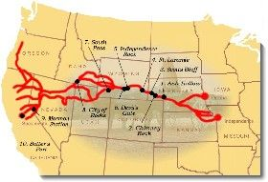
The overland route
30,000 made this journey 1849 150,000 by 1852 …
Cholera arrives in US 1830’s
….from India…10% die on route,
95% by disease less than 350
from Indian raids…
Indians raid but few attacks
on wagon trains… and kill
350 travellers 1849-1860
Emigrants kill off wildlife,
contaminate rivers
…spread cholera among
Tribes…30% death rate

Slide 38
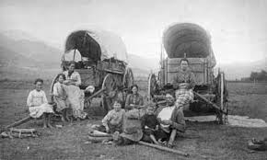
Overland route
30% wagon trains turn back
Due to conditions or decided
To settle on route
Travellers mostly men, but
Some entire families
….searching for a new life…

Slide 39
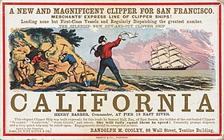
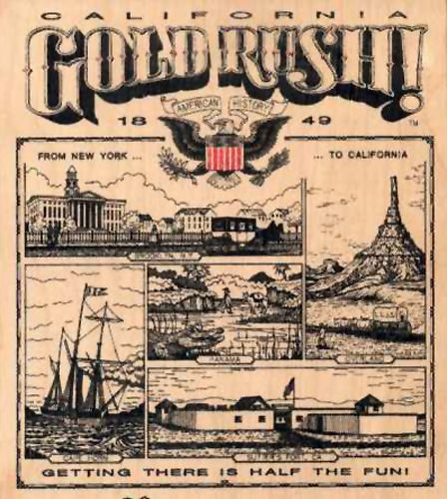
Steam ship advertisement
Boom in shipping across Europe & USA $400..$600 ($24,000 today)
for ‘luxury’ via Panama route … $200….’cattle class” round Horn

Slide 40
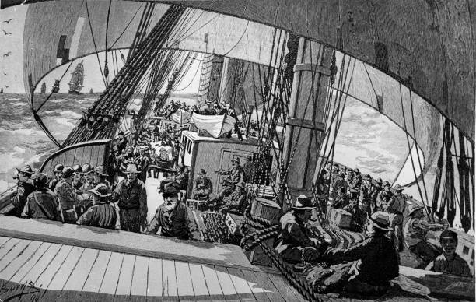
The Sea voyage
Segregated by income..
Weeks of gambling &
drinking
97% men, usually in
companies as land ..but
dissolve on arrival
4% death rate on voyages
Around Cape Horn….20%
travelling across Isthmus to
Pacific

Slide 41
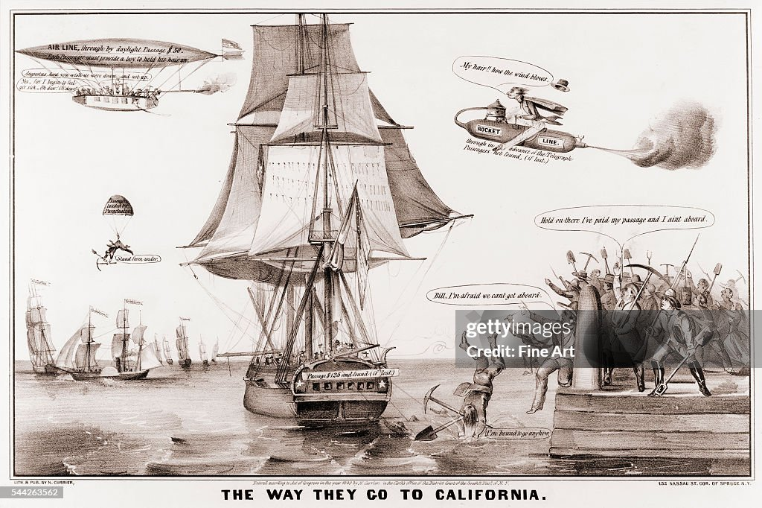
Gold Fever ridiculed

Slide 42
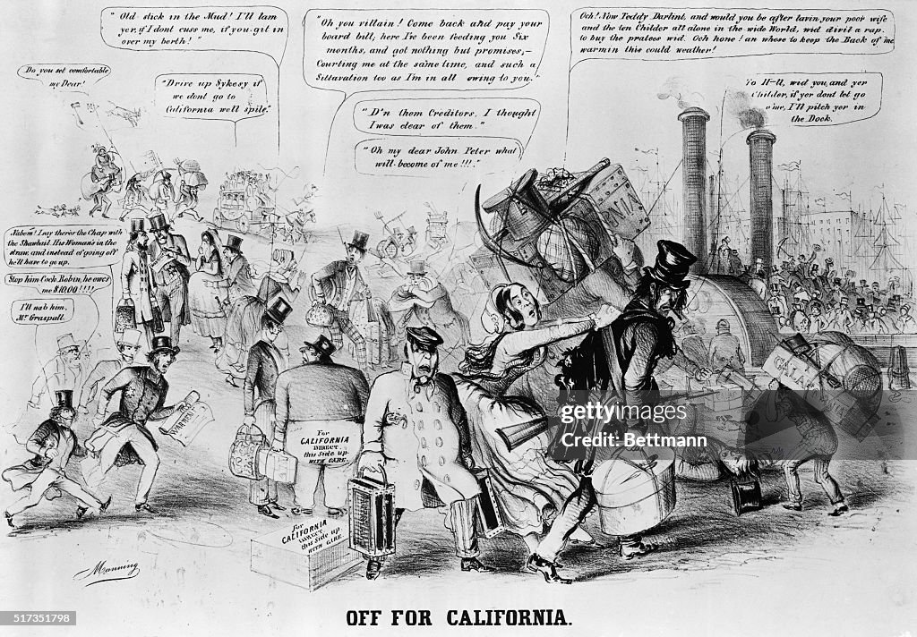

Slide 43
Sweet Betsy and Pike (1)
Refrain
Did you ever hear tell of Sweet Betsy from Pike,
Who crossed the wide mountains with her lover Ike,
Two yoke of cattle, a large yeller dog,
A tall Shanghai rooster, and a one-spotted hog.
Singing too-ra-li-oo-ra-li-oo-ra-li-ay.
They swam the wide rivers and crossed the tall peaks,
And camped on the prairie for weeks upon weeks.
Starvation and cholera, hard work and slaughter--
They reached California 'spite of hell and high water.
Refrain
The wagon broke down with a terrible crash,
And out on the prairie rolled all sorts of trash.
A few little baby-clothes, done up with care,
Looked rather suspicious, but all on the square.
Refrain

Slide 44
Sweet Betsy and Pike (2)
Refrain
The Shanghai ran off, and the cattle all died,
That morning the last piece of bacon was fried.
Ike got discouraged, Betsy got mad,
The dog drooped his tail and looked wonderfully sad.
Refrain
Long Ike and Sweet Betsy attended a dance.
Ike wore a pair of his Pike County pants.
Betsy was covered with ribbons and rings.
Says Ike, "You're an angel, but where is your wings?"
Refrain
This Pike County couple got married, of course,
But Ike became jealous, and obtained a divorce.
Betsy, well-satisfied, said with a shout,
"Goodbye, you big lummox, I'm glad you backed out!"

Slide 45
Intermission

Slide 46
Year One….the golden time

Slide 47
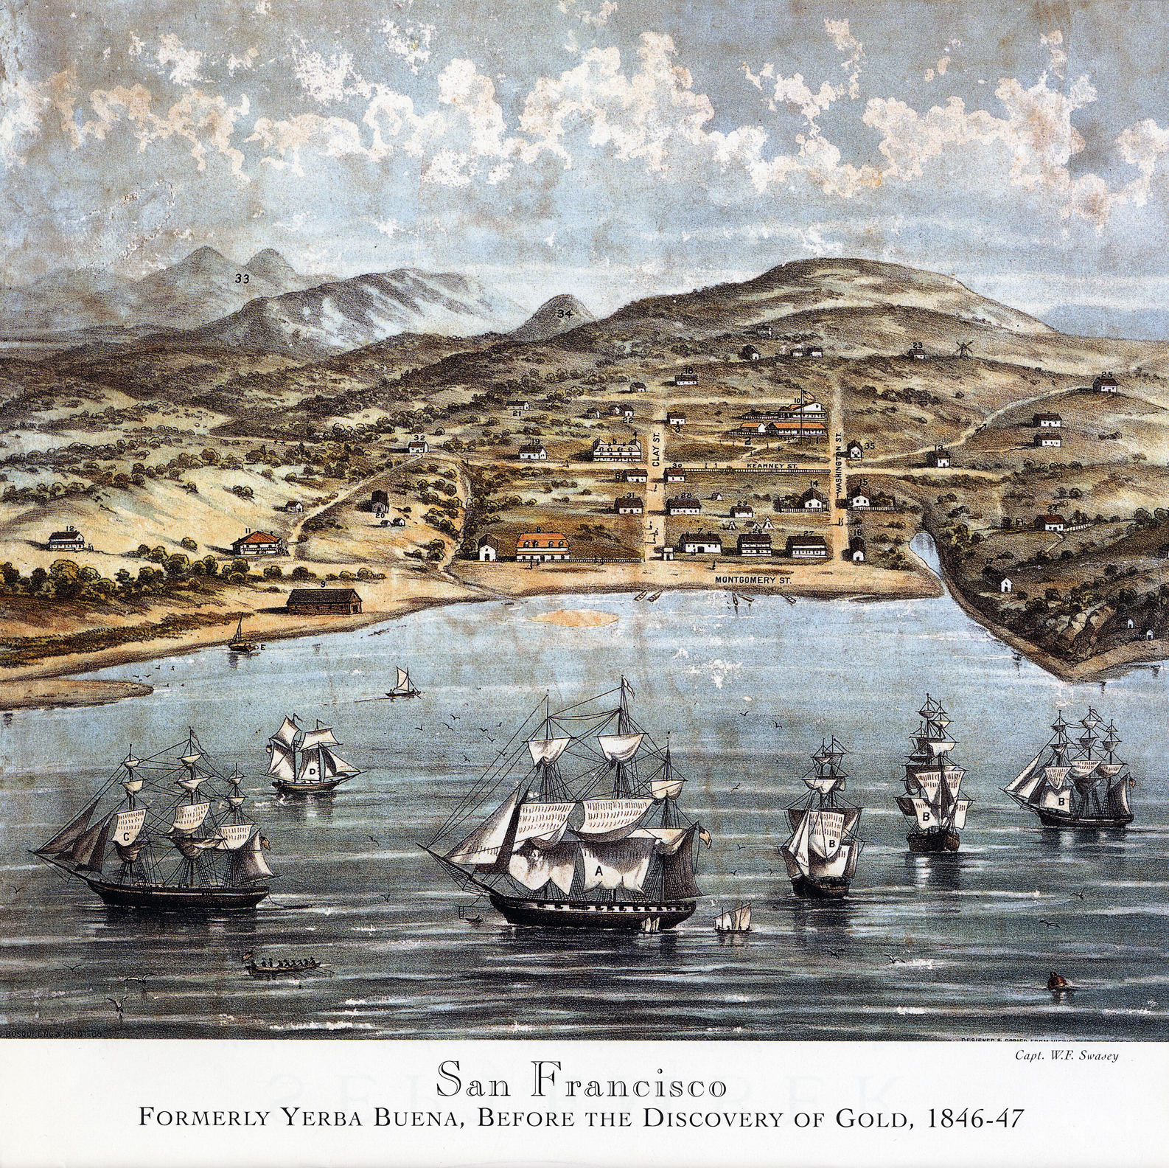
San Francisco …before gold 1847
300 residents
Ships carrying
agricultural products,
US warships
patrolling coast
…threat of British,
& Russians

Slide 48
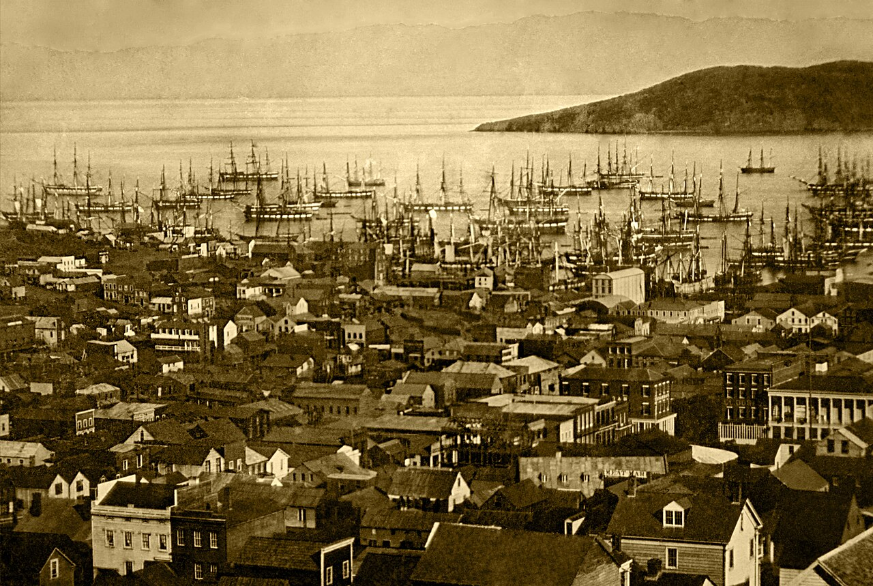
San Francisco year 1850
Population 25,000 by 1851
Crews desert ships as they
Arrive …and head for mines,
Soldiers abandon army
Empty ships brought on
Shore…converted to
Warehouses, lodgings
..and brothels

Slide 49
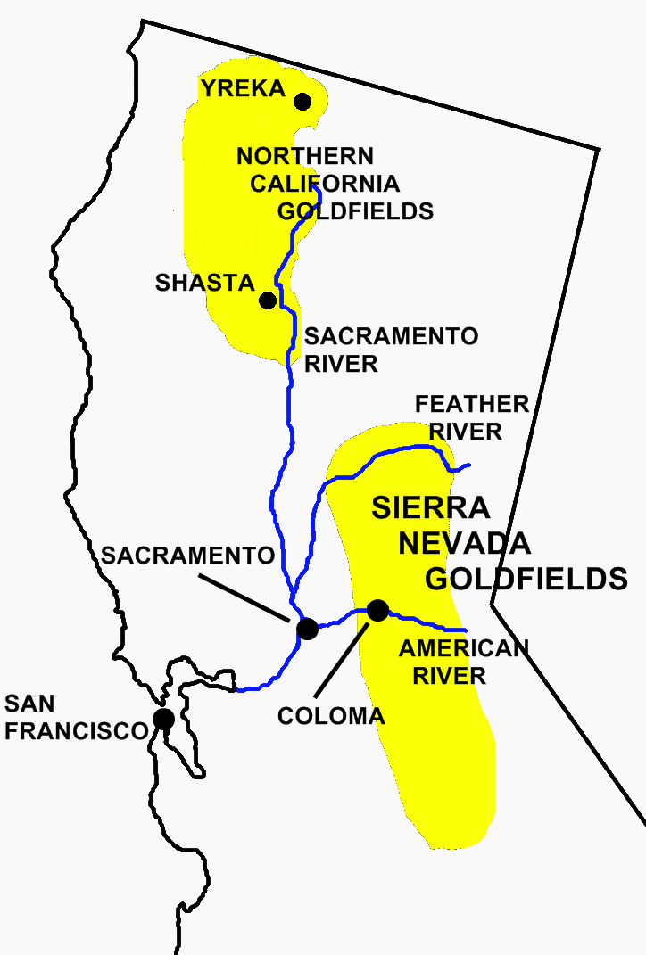
The Gold fields
Gold found in many places
Along inland mountains
….coast and South unaffected
Most early finds exposed
on river beds and easy to get
More land than people,
collaboration not competition
….no property law….claims
established by physical presence

Slide 50
California 1849
Military Government….no legislature or regulations and no one to enforce them…all gone to join mines
No Civil Service or land offices……squatters occupy Sutter’s Empire
…..spends rest of his life trying to get it back….and failing
1849 relatively peaceful…limitless opportunity…..’lawless order’ of manners and rule by vigilantes, ‘justice’ swift, lethal and uncertain
Mountain Wild life (Including Grizzlies) exterminated
Indians starve, succumb to disease, or become ‘slaves’ to miners

Slide 51
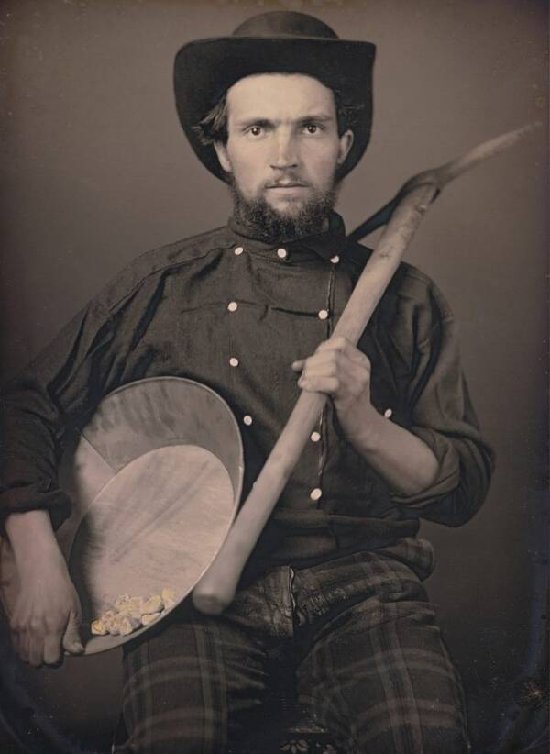
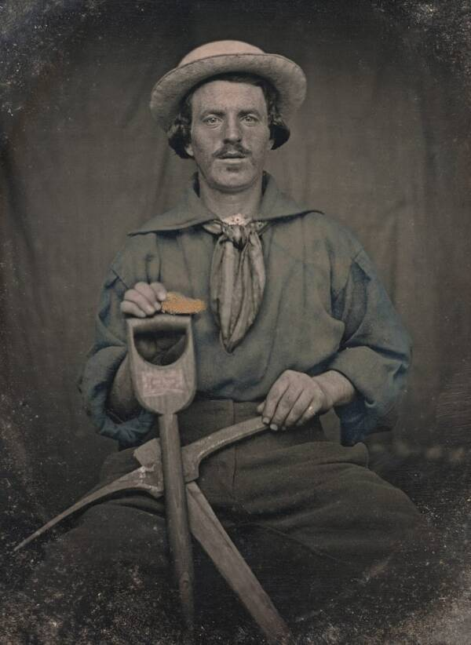
49ers: young, optimistic, many heavily armed…

Slide 52
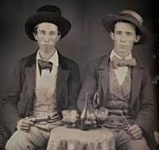
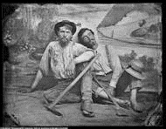

Slide 53
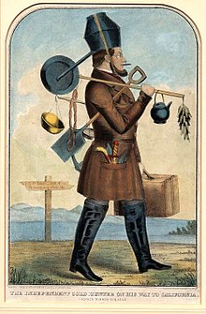
…subject to ridicule…”The complete gold miner”… (Samuel Brannon customers?) 0

Slide 54
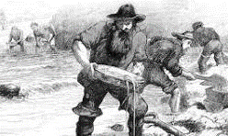
Panning for Gold

Slide 55
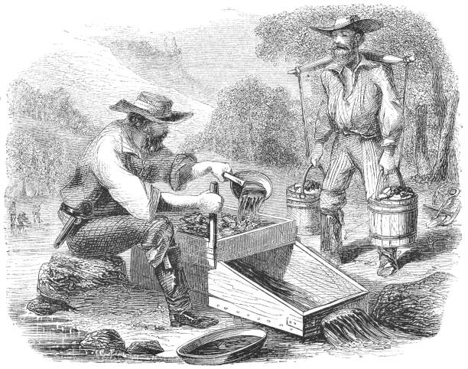
Early machines. Cradles…gold caught in sieves

Slide 56
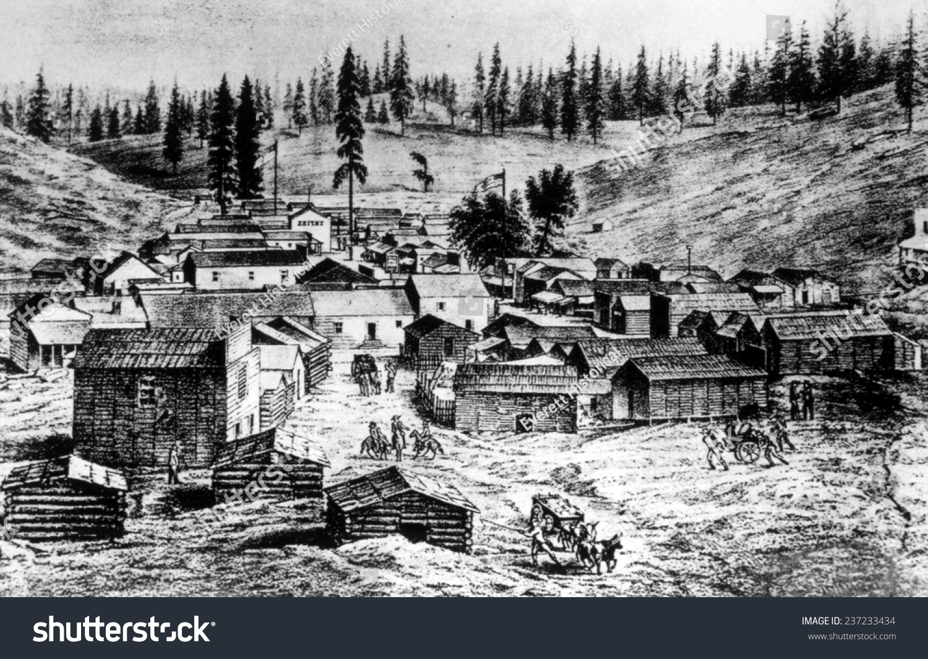
Instant cities……abandoned when mines run out

Slide 57
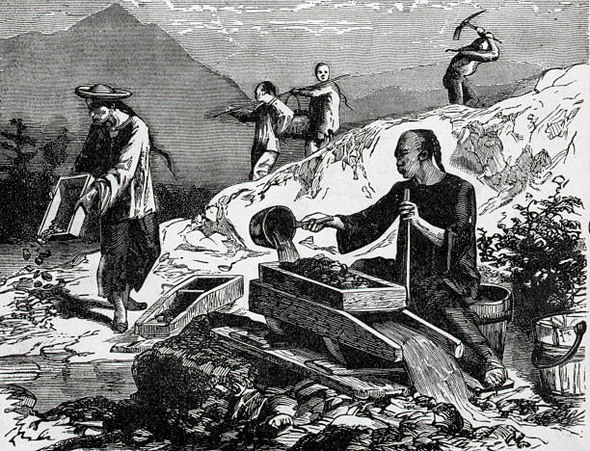
Chinese Gold mining

Slide 58
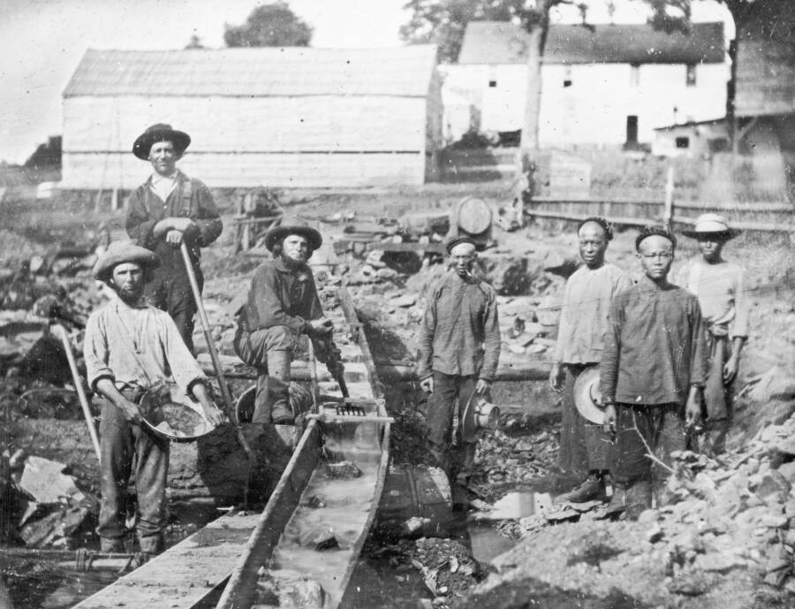
Working together ….at first

Slide 59
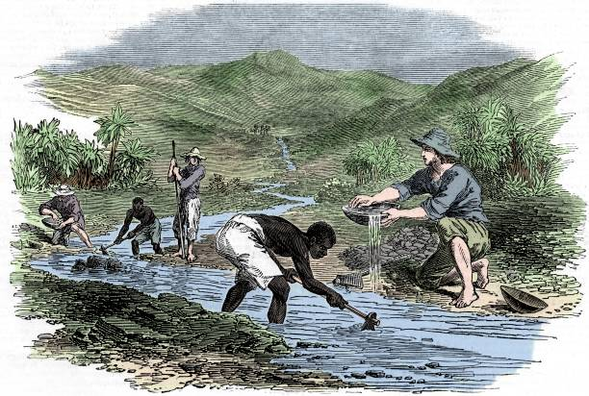
Southerners bring slaves to recreate their economy….tolerated by ‘free miners’…..at first

Slide 60
Communal effort: plenty for all, collaboration on a great adventure….20% become prosperous, 5% rich

Slide 61
Emerging Tensions
Good feelings of 1849 ….too good to last
Huge population young white men, away from mums and sisters, strange place,
multi cultural an abundance of booze and guns
Inflation…all goods imported, nothing made …males quit jobs to work the mines
Mining yields decline/ population soars during 1850’s…everyone a threat
Indians forced to steal to avoid starvation
Chinese work too hard and retain corporate organisation
Southerners seek to replace miners with slave labour
Californios ..many become bandits as lands often seized by Anglo settlers

Slide 62
Gold fields become a murder zone…bad for business ….and life expectancy
Business interests requires Order
…..the creation of a Golden State

Slide 63
The Golden State

Slide 64
Increased population/ declining yield/arrival of corporations.
Declining Yields
Gold
Year Population Yield (excl Indians) (tons)
1848 20,000 5
1849 90,000 50
1850 150,000 100
1851 250,000 80
1852 300,000 75
(Average daily wage US industrial worker $2)

Slide 65
Rule of “Judge Lynch”
Sites self regulating, problem of “claim jumping” …rising poverty as fewer get rich and population increase…trials ‘fair’, fast, and lethal

Slide 66
How violent? (homicides per 100,000..100 = 1% chance of getting murdered each year)
 | England | USA
1700 | 8.9 | 30.0
1800 | 5.0 | 20.0
1850 | 3.0 | 15.0
2020 | 1.0 | 7.0
Average for California 1850…..65.0 per 100,0000
…Mining communities …..87.00….several 100+
…British Columbia 1855-1857….2.5
(Ohio State University…Homicides in US Randolph Roth 20210)
Ecuador, Venezuela …today 120.0, Mexico 75.0

Slide 67
State Government established….fast
Constitution written 1849 and ratified same year,…approved by Congress…California “free state” 1850
Universal white male suffrage
Slavery “outlawed”…..existing slaves become indentured servants
Women allowed own property, get divorced…state needs women
Public education, taxation, civil service
Property and corporate law systems. State Supreme Court
State Government turns attention on enforcing “Manifest Destiny”

Slide 68
Golden State Governance
Peter Burnett ( 1807-1895)
Missouri slave owner, moves to Oregon to escape debt …authors “lash law”…whipping free blacks who do not leave state
Moves to California, elected Governor 1849-1851
Passes “Act for the Preservation and Protection of
Indians” 1850
…..children to be removed from parents
…..adults to moved to reservations ..or shot
…. no Indian legal representation
…..funds State Militia to enforce

Slide 69
The politics of Manifest Destiny……
Act of Preservation and Protection of Indians in practice
“that a war of extermination will continue to be waged
between the races until the Indian race becomes
extinct must be expected.”
Foreigner Miners Act….non white miners to pay $20 ($500)
a month in 2024 money) …reduced to $5….removes Chinese from mines
…move to cities. Laundry, services, banking, trade. Legislature moves
To remove from state….until railroads and need for workers
Regarding free and enslaved blacks…attempts to impose “lash law” …but fails since most blacks already indentured servants…and valuable

Slide 70
State Policy: Mass Killings and random murder
“Protecting the Settlers”
(Harpers Magazine 1874)
Hidden history
..not taught in schools. Till now
..documented, not reported
Massacres occur throughout
Sierra Nevada
….Old Shasta Tow -300,
….Bridge Gulch….150,
….Yontocket Massacre….500.
Exposed by “California Genocide”
Benjamin Madley `2016

Slide 71
Yontocket Massacre…memoirs of Militia member
“The people got all around them… Every time
someone go out, never come back in… they set fire
to the house, the Indians' house. You could see
them just cutting heads off. They stick them things
into them; pretty soon they pick them up and throw
them right into the fire. Some of 'em tried to get
away, run down the slough. Soon as they get down
there, if they don't get 'em right away, they get 'em
from the other side when they come up. Shoot 'em
right there, waiting for them”

Slide 72
California Genocide
Indians become slaves and resist…murder some overseers…State funds militia of 30,000 to relocate to Indians to reservations)…easier to kill
Newspapers (East Coast)report crimes but zero prosecutions
Shasta and other towns offer “head bounties” .$25 for male corpse $5 woman or child,
Most killings those of individual Indians and families and not recorded
Killings continue to 1870’s…..moral repulsion + lack of Indians to kill and intervention by Grant Administration.
Native Indian population declines from 150,000 1848 to 15,000 1870

Slide 73
Industrialised mining and land “wars”

Slide 74
Corporations divert rivers to access river bottoms

Slide 75
New Technologies introduced as miners become employees (“Long Tom” Sluice)

Slide 76
Mining goes underground

Slide 77
Hydraulic mining: pioneered 1850’s…blast hillsides to recover gold

Slide 78
Expanded to remove sides of mountain ranges insidesmountainsidestechnology improved

Slide 79
Mass introduction 1870’s….

Slide 80
Wildlife exterminated…hillsides made barren…150 years later

Slide 81
Rivers silt up…land made toxic

Slide 82
Hydraulic legal “war”
3,000 square miles farmland made toxic by metre thick “slickens”, towns flooded by rising rivers
Legal disputes 1860-1880
Farmers become more dominate than miners as Citrus, cotton, salads and other crops become “new gold” as railroads and refrigeration enables California to ship products east
Hydraulic Mining banned 1882,,,,reintroduced 1900’s but regulated

Slide 83
Women during the Gold Rush

Slide 84
A Land of men
Limited options for mid 19th century women: marriage,
Domestic service, factory work, teaching, prostitution
California was the place for
Independent woman to be

Slide 85
Women allowed….but very few

Slide 86
Eliza Farnham (1815-1864)
Brought up in New York foster home….marries lawyer…Intellectual phrenologist and Prison reformer, husband joins gold rush, goes to California 1849 to settle husband’s estate on his death
Wrote “California indoors and out”..
…streets of men watching her as only
Woman present
Returns to New York establishes Institutes to support destitute women In West,
Dies nursing in civil war…consumption

Slide 87
Luzena Wilson (1820-1902)
Walks to California with husband and two children 1849
“The road was lined with the skeletons of the poor beasts who had died in the struggle ... Sometimes we found the bones of men bleaching beside their broken-down and abandoned wagons. he buzzards and coyotes, driven away by our presence from the horrible feasting, hovered just out of reach”
Husband goes to mines, creates restaurant in Sacramento …$10 biscuits…makes fortune.. flood. Moves to mining camp, buys hotel…fire
Moves to another camp. Buys hotel….recovers
Fortune. Husband disappears.. retires wealthy,
brings up children. Lives to 82

Slide 88
Lola Montez (1821-1861)…part 1
Born Maria Dolores Gilbert Ireland. Father soldier to India. Father dies & mother returns to Ireland,.
Elopes to India with lieutenant at age 16..separates 5 years later. Becomes “Spanish Dancer”….new name +”spider dance” …entertains soldiers….secures promoter
European tour… mistress to Listz, & Alexander Dumas, courtesan to Bavarian ‘mad king’ Ludwig…radical reformer.. Flees revolution 1848, liberal reformer and hated by church….Revolution of 1848…flees to England

Slide 89
Lola Montez Part 2
Remarries.. Accused of bigamy…separates from ‘husband’
…who later drowns
Moves to New York…advertises herself as the “Countess”
Moves to California 1853….marries publisher . Accused of adultery,
accuser killed…needs to leave the state
Moves to Australia to join new Gold Rush. Attacked by church
…dance considered “ 'utterly subversive to all ideas of public morality'. …
Returns to New York and dies of consumption age 39

Slide 90
The nameless ‘entertainers’
San Francisco Bordello….early 1860’s
Thousands migrate to California
as waitresses, domestics, future
Wives and prostitutes
No rules or prejudice till late
1850’s…called “Entertainers”
…many hired for company
only $14 to attend dinner
Some become wealthy
..more die from diseases with
2 years of arrival

Slide 91
Legacy & Cultural Impact

Slide 92
Gold mining continues…..underground

Slide 93
California Indian Reservations today
Few, small, most
In low desert
…. little water
…..vegetation
…..wild life
Rejuvenated
by development
Of Casino industry
In 1990’s…Reagan
& Tribal Sovereignty
Act…

Slide 94
Morongo Indian Gaming Resort

Slide 95
Impact on USA
$17 Billion dollars in gold (2020 prices) by 1860…increase in money supply invested in US…and most to industrialising north and east
Supports “Manifest Destiny”
Get Rich quick culture.. “survival of the fittest”…a new American culture
Power shift to East Coast Finance Centres
Intensifies slavery issue….California a free state.
South needs to expand to keep up

Slide 96
USA 1850’s Continental Superpower victorious in war and more wealthy
than its founders could imagine with all issues resolved except one
………………SLAVERY
Resolving that issue and the conversion of America from Continental
to World Power is the subject of Module 3

